Slide 1

A Project Presentation on Hospital Management System
Submitted To:-
A.M.PATEL INSTITUTE OF COMPUTER
GANPAT STUDIES,KHERVA,
Mehsana
B.C.A. Semester:-v
Group no: 106
Guide By:-
Ass.Prof.Nilesh patel
B.C.A. Department,
AMPICS,KHERVA
Submitted By:-
Thaker Samarth(23032211242)
Parmar Harshvardhan(23032211120)

Slide 2
Project Profile
Project title | Hospital Management System
Objective | The Hospital Management System (HMS) aims to digitize and automate hospital operations by managing patient records, appointments, billing, and resources efficiently. It provides role-based access for admins, doctors, staff, and patients to improve workflow efficiency and patient care quality.
Types of application | Web Based Application
Development by | Thaker Samarth R. Parmar Harshvardhan P.
Front-end tool | Html,Css,Javascript,Bootstrap
Back-end tool | Python,Django,MYSQL,
Other tool | Visual Studio Code
Internal guild | Pro.Nilesh Patel
Submitted to | GANPAT UNIVERSITY A.M. PATEL INSTITUTE,KHERVA

Slide 3
EXISTING SYSTEM

Slide 4
The existing Hospital Management System (HMS) is a web-based application developed using Django for the backend and Bootstrap 5 for the frontend. The system follows the Django MVT (Model–View–Template) architecture and uses SQLite as the default database. It is designed to manage hospital operations digitally with role-based access and modular functionality.
Admin
Full access to system configuration
User and department management
Reporting and analytic
Doctor
Access to patient medical records
Appointment management
Digital prescriptions and discharge summaries

Slide 5
Staff
Receptionist
Patient registration
OPD/IPD management
Appointment handling
Billing and payments
Lab Technician
Manage lab test requests
Upload and maintain lab reports
Patient
View personal medical records
Book appointments
Access prescriptions and billing details

Slide 6
Need for new system

Slide 7
The need for a comprehensive Hospital Management System (HMS) arises from the limitations of traditional manual and legacy hospital processes. To achieve operational excellence, improve patient care, and ensure accurate data management, a modern digital solution is essential.
Data Redundancy and Errors
Time-Consuming Information Retrieval
Billing Leakage
Inventory and Resource Mismanagement
Lack of Analytical Insights
Centralized Database
Improved Operational Efficiency
Enhanced Financial Control
Better Patient Care
Real-Time Monitoring
Role-Based Data Security

Slide 8
MINIMUM HARDWARE AND SOFTWARE REQUIREMMENT
Server-Side Requirment
Operating System | Window-11
Runtime Environment | DJANGO
Back-End-Tool | Microsoft SQL Server
Client-Side Requirement
Operating System | Window-10&Above
Web Browser | Any Compatible Browser

Slide 9
MINIMUM HARDWARE AND SOFTWARE REQUIREMENT
Server-Side Requirement
Processor | Intel(R)Core(TM)2.30GHz
RAM | 4GB
Hard Disk | 50GB&Onward
Client-Side Requirement
Processor | Dual Core & Onward
RAM | 2GB
Hard Disk | 5GB(Free Space)

Slide 10
F low Chart

Slide 11
Start
Login
User Role
No
Error
Admin Dashboard
Doctor Dashboard
Yes
Patient Dashboard
Manage Departments & Settings
View OPD/IPD Patients
View Medical Records
Book Appointments
User Management
Prescriptions
Staff
Online Payments
Financial Reports
IPD Treatment & Discharge Summary
Manage Profile
Operational Analytics
Manage Schedule

Slide 12
Receptionist Dashboard
Lab Technician Dashboard
Patient Registration
View Lab Test Requests
Appointment Management
Upload Lab Reports
OPD/IPD Management
Billing & Payments
Log Out
End

Slide 13
Level 0:Context Diagram
Hospital Management System
Confing & User Data
Reports & Status
Admin
Doctor
Reports & Status
Alqnontment Process
Patient Record
Patient Record
Diagnosis &
Availability
Appointment &
Prescription
Patient
Registration
Appointment
Staff
(Receptionist/lab)
Registration &
Payment
Patient Record
Appointment &
Prescription
Admit/Discharge & Billing

Slide 14
Level 1:System Decomposition
Admin
Patient
Doctor
Staff (Receptionist/Lab)
Hospital Management System
1.0
Authentication
2.0
Patient Management
3.0
Appointment & OPD
4.0
Billing
& Payments
5.0
Doctor Interface
6.0
Lab Management
User
DB
Patient
DB
Appointment
DB
Payment
DB
Doctor
DB
Bed/Ward
DB
Reports
DB

Slide 15
Data Dictionary

Slide 16
Table Name:-Customer
Description:- Stores authentication details and role-based user
types for the system.
Field Name | Data Type | Size | Constraints | Description
id | AutoField | — | PK | Unique user ID
username | CharField | 150 | Unique, Not Null | Login username
password | CharField | — | Not Null | Encrypted password
email | EmailField | 254 | Optional | Email address
user_type | CharField | 10 | Choices, Not Null | admin / doctor / patient / staff
phone | CharField | 15 | Null | Contact number
is_active | BooleanField | — | Default True | Account status
date_joined | DateTimeField | — | Auto | Registration date

Slide 17
Table Name:-Department
Description:- Maintains hospital departments and their basic information.
Field Name | Data Type | Size | Constraints | Description
id | AutoField | — | PK | Department ID
name | CharField | 100 | Not Null | Department name
description | TextField | — | Optional | Department description

Slide 18
Table Name:-Admin
Description:- Holds profile details of system administrators.
Field Name | Data Type | Size | Constraints | Description
id | AutoField | — | PK | Admin ID
user | OneToOneField | — | FK, Unique | Linked CustomUser
name | CharField | 200 | Not Null | Admin name
profile_image | ImageField | — | Optional | Profile photo

Slide 19
Table Name:-Doctor
Description:- Stores doctor profiles, specialization, availability, and
department mapping.
Field Name | Data Type | Size | Constraints | Description
id | AutoField | — | PK | Doctor record ID
user | OneToOneField | — | FK, Unique | Linked CustomUser
doctor_id | CharField | 10 | Unique | Doctor code (DOC001)
first_name | CharField | 100 | Not Null | First name
last_name | CharField | 100 | Not Null | Last name
department | ForeignKey | — | FK, Null | Department
specialization | CharField | 100 | Not Null | Specialization
phone | CharField | 15 | Not Null | Contact number
email | EmailField | 254 | Not Null | Email
availability_status | CharField | 20 | Choices | Available / On Leave / Emergency
is_first_login | BooleanField | — | Default True | First login flag
profile_image | ImageField | — | Optional | Profile image
created_at | DateTimeField | — | Auto | Created time

Slide 20
Table Name:-Staff
Description:- Manages non-doctor hospital staff such as receptionists and
lab technicians.
Field Name | Data Type | Size | Constraints | Description
id | AutoField | — | PK | Staff ID
user | OneToOneField | — | FK, Null | Linked CustomUser
staff_id | CharField | 10 | Unique | Staff code (STF001)
name | CharField | 200 | Not Null | Staff name
role | CharField | 50 | Choices | Receptionist / Lab Technician
department | ForeignKey | — | FK, Null | Department
phone | CharField | 15 | Not Null | Contact number
email | EmailField | 254 | Not Null | Email
profile_image | ImageField | — | Optional | Profile image
joining_date | DateField | — | Auto | Joining date

Slide 21
Table Name:-Patient
Description:- Contains patient demographic details, contacts, and identifiers.
Field Name | Data Type | Size | Constraints | Description
id | AutoField | — | PK | Patient record ID
user | OneToOneField | — | FK, Unique | Linked CustomUser
patient_id | CharField | 10 | Unique | Patient code (PAT001)
name | CharField | 200 | Not Null | Patient name
age | IntegerField | — | Not Null | Age
gender | CharField | 10 | Choices | Male / Female / Other
blood_group | CharField | 5 | Optional | Blood group
phone | CharField | 15 | Not Null | Contact number
email | EmailField | 254 | Not Null | Email
address | TextField | — | Optional | Address
emergency_contact | CharField | 15 | Null | Emergency contact
id_proof_number | CharField | 50 | Null | ID proof
profile_image | ImageField | — | Optional | Profile image
created_at | DateTimeField | — | Auto | Created date

Slide 22
Table Name:-OPD Appointment
Description:- Records outpatient appointments between patients and doctors.
Field Name | Data Type | Size | Constraints | Description
id | AutoField | — | PK | Appointment ID
patient | ForeignKey | — | FK | Patient
doctor | ForeignKey | — | FK, Null | Doctor
appointment_date | DateTimeField | — | Not Null | Appointment date & time
reason | TextField | — | Not Null | Visit reason
status | CharField | 20 | Choices | Pending / Completed / Cancelled
fee | DecimalField | 10,2 | Default 0 | Consultation fee
token_no | IntegerField | — | Null | Token number
visit_type | CharField | 20 | Choices | New / Follow-up
created_at | DateTimeField | — | Auto | Created date

Slide 23
Table Name:-Bed
Description:- Manages hospital beds, ward types, charges, and availability status.
Field Name | Data Type | Size | Constraints | Description
id | AutoField | — | PK | Bed ID
ward_type | CharField | 20 | Choices | General / ICU / Private
bed_number | CharField | 10 | Unique | Bed number
daily_charge | DecimalField | 10,2 | Not Null | Charge per day
status | CharField | 20 | Choices | Available / Occupied / Maintenance

Slide 24
Table Name:-IPD Admission
Description:- Tracks inpatient admissions, bed allocation, and
discharge status.
Field Name | Data Type | Size | Constraints | Description
id | AutoField | — | PK | Admission ID
patient | ForeignKey | — | FK | Patient
doctor | ForeignKey | — | FK, Null | Doctor
bed | ForeignKey | — | FK, Null | Bed
ward_no | CharField | 50 | Not Null | Ward number
bed_no | CharField | 50 | Not Null | Bed number
reason | TextField | — | Not Null | Admission reason
admission_type | CharField | 20 | Choices | Emergency / Planned
admission_date | DateTimeField | — | Auto | Admission date
expected_discharge_date | DateField | — | Null | Expected discharge
discharge_date | DateTimeField | — | Null | Discharge date
is_discharge_requested | BooleanField | — | Default False | Discharge request
status | CharField | 20 | Choices | Admitted / Discharged

Slide 25
Table Name:-Payment
Description:- Stores billing and payment transactions including online
gateway details.
Field Name | Data Type | Size | Constraints | Description
id | AutoField | — | PK | Payment ID
patient | ForeignKey | — | FK | Patient
amount | DecimalField | 10,2 | Not Null | Payment amount
payment_method | CharField | 20 | Choices | Cash / Online / Insurance
transaction_id | CharField | 100 | Optional | Transaction reference
razorpay_order_id | CharField | 100 | Null | Razorpay order ID
razorpay_payment_id | CharField | 100 | Null | Razorpay payment ID
razorpay_signature | CharField | 200 | Null | Razorpay signature
payment_date | DateTimeField | — | Auto | Payment date
description | TextField | — | Optional | Payment purpose

Slide 26
Table Name:-OTP
Description:- Handles one-time password generation and verification
for users.
Field Name | Data Type | Size | Constraints | Description
id | AutoField | — | PK | OTP ID
user | ForeignKey | — | FK | CustomUser
otp_code | CharField | 6 | Not Null | OTP code
created_at | DateTimeField | — | Auto | Created time
expires_at | DateTimeField | — | Not Null | Expiry time
is_verified | BooleanField | — | Default False | Verification status
attempts | IntegerField | — | Default 0 | Attempts count

Slide 27
Table Name:-Doctor Schedule
Description:-Defines weekly availability schedules for doctors.
Field Name | Data Type | Size | Constraints | Description
id | AutoField | — | PK | Schedule ID
doctor | ForeignKey | — | FK | Doctor
day_of_week | CharField | 10 | Choices | Day of week
start_time | TimeField | — | Not Null | Start time
end_time | TimeField | — | Not Null | End time

Slide 28
Table Name:-Prescription
Description:- Stores diagnosis, medicines, and follow-up details prescribed
by doctors.
Field Name | Data Type | Size | Constraints | Description
id | AutoField | — | PK | Prescription ID
patient | ForeignKey | — | FK | Patient
doctor | ForeignKey | — | FK | Doctor
appointment | ForeignKey | — | FK, Null | OPD Appointment
diagnosis | TextField | — | Not Null | Diagnosis
medicines | TextField | — | Not Null | Medicines & dosage
advice | TextField | — | Optional | Advice
follow_up_date | DateField | — | Null | Follow-up date
created_at | DateTimeField | — | Auto | Created date

Slide 29
Table Name:-Lab Report
Description:- Manages laboratory test requests and uploaded reports
for patients.
Field Name | Data Type | Size | Constraints | Description
id | AutoField | — | PK | Report ID
patient | ForeignKey | — | FK | Patient
doctor | ForeignKey | — | FK | Doctor
test_name | CharField | 200 | Not Null | Test name
report_file | FileField | — | Null | Uploaded report
status | CharField | 20 | Choices | Pending / Uploaded
remarks | TextField | — | Optional | Remarks
requested_date | DateTimeField | — | Auto | Request date

Slide 30
Table Name:-Chat Session
Description:- Tracks chat sessions for users and anonymous visitors.
Field Name | Data Type | Size | Constraints | Description
id | AutoField | — | PK | Session ID
user | ForeignKey | — | FK, Null | CustomUser
session_id | CharField | 100 | Unique | Session identifier
started_at | DateTimeField | — | Auto | Session start

Slide 31
Table Name:-Chat Message
Description:- Stores individual messages exchanged within chat sessions.
Field Name | Data Type | Size | Constraints | Description
id | AutoField | — | PK | Message ID
session | ForeignKey | — | FK | ChatSession
sender | CharField | 10 | Choices | user / bot
message | TextField | — | Not Null | Message content
timestamp | DateTimeField | — | Auto | Sent time

Slide 32
Table Name:-Discharge Summary
Description:- Records final diagnosis, treatment, and advice at
patient discharge.
Field Name | Data Type | Size | Constraints | Description
id | AutoField | — | PK | Summary ID
admission | OneToOneField | — | FK, Unique | IPD Admission
patient | ForeignKey | — | FK | Patient
doctor | ForeignKey | — | FK | Doctor
diagnosis | TextField | — | Not Null | Final diagnosis
treatment_given | TextField | — | Not Null | Treatment details
final_advice | TextField | — | Not Null | Discharge advice
follow_up_plan | TextField | — | Not Null | Follow-up plan
created_at | DateTimeField | — | Auto | Created date

Slide 33
E-R DIAGRAM

Slide 34
Customer User
User_id(PK)
Username
Password
Role
Has profile
Has profile
Has profile
Has profile
Has profile
Has profile
Admin
Admin_id(PK)
User_id(FK)
name
Doctor
Doctor_id(PK)
User_id(FK)
Department_id specialization
Patient
Patient_id(PK)
User_id(FK)
Age
Gender_contact
Staff
Staff_id(PK)
User_id(FK)
role
Department_id
DoctorSchedule
1.schedule_id(PK)
Department
1.department_id(PK)name
LabReport
1.chatsesix(PK)
employs
treats
employs
concults

Slide 35
Doctor
Doctor_id(PK)
User_id(PK)
Department_id(PK)
specialization
Patient
patient_id(PK)
User_id(PK)
Age
Gender
staff
staff_id(PK)
User_id(PK)
Department_id(FK)
department
books
books
occupies
May to
pays
Department
Department_id(PK)
name
IPDAdmission
admission_id(PK)
bed_id(PK)
Admission_date
Discharge_date
Result in
DischargeSummary
Discharge_id(PK)
employs
employs
gernerates
Doctor
Patient_id(PK)
doctor_id(PK)
Role
Department_id(PK)
Payment
payment_id(PK)
message_id(FK)
text
handles
Doctor(PK)
1.department_id(PK)
participates
mode
contains

Slide 36
chatsession
session_id(PK)
patient_id(PK)
doctor_id(PK)
chatsession
session_id(PK)
sender
message
Chatmessage
1.messaged(PK)
Chatmessage
1.messaged_id(PK)

Slide 37
Process Description

Slide 38
Brief Description Of Admin
1. Admin Process
The Admin has full control over system configuration, user management, and reporting.
1.1 User Management
Doctors
Add Doctor: Create new doctor profiles with details such as Name, Specialization, Department, Contact Information, and Consultation Fees.
Manage Doctor: Edit or delete existing doctor profiles.
View Doctors: Access a complete list of doctors along with their availability status.
Staff
Add Staff: Register staff members such as Receptionists and Lab Technicians.
Manage Staff: Update staff details, roles, and access permissions.

Slide 39
Patients
View Patients: Access the complete database of registered patients.
Manage Patients: Edit patient details or deactivate records if required.
Add Patient :Register new patients directly from the admin panel when needed.
1.2 Setup & Configuration
Departments: Create, update, and manage hospital departments (e.g., Cardiology, Neurology, Orthopaedics).
Wards & Beds: Configure IPD infrastructure by creating wards and assigning beds with availability status.
1.3 Reports & Analytics
Admin Dashboard: View high‑level statistics such as total revenue, active doctors, and today’s appointments.
Financial Reports: Generate revenue reports for appointments, IPD admissions, and pharmacy sales.
Data Export: Download doctor lists, patient lists, and financial reports in PDF or Excel format.

Slide 40
Brief Description Of Doctor
2. Doctor Process
2.1 Dashboard & Schedule
Appointment List: View daily appointments and patient queues.
Availability Status: Update availability (Available, On Leave, Emergency), visible to reception staff.
2.2 Consultation (OPD)
Patient History: View previous visits, prescriptions, and medical records.
Digital Prescription Creation:
Diagnosis: Clinical findings and observations.
Medicines: Drug name, dosage, and frequency.
Advice: General health instructions and precautions.

Slide 41
2.3 IPD Management
Ward Rounds: View and manage admitted patients assigned to the doctor.
Discharge Summary: Prepare a detailed discharge summary including treatment provided, final diagnosis, and follow‑up instructions.
2.4 Diagnostics
Lab Test Requests: Order required lab tests for patients.
View Reports: Access uploaded lab reports for diagnosis and review.

Slide 42
Brief Description Of Patient
3. Patient Process
3.1 Registration & Access
Sign Up: Self‑register using personal details via the public portal.
Login: Secure login using Email or Patient ID and password (OTP‑based verification if enabled).
3.2 Appointments
Book Appointments: Search doctors by specialization and book appointments online.
Appointment Status: View and track appointment status.

Slide 43
3.3 Medical Records
Prescriptions: View and download digital prescriptions from previous consultations.
Lab Reports: Download lab test results uploaded by the laboratory.
Discharge Summaries: Access discharge summaries from past IPD admissions.
3.4 Payments
My Bills: View paid and pending bills.
Online Payments: Pay bills securely through the integrated payment gateway (Razorpay).
Receipts: Download payment receipts for future reference.

Slide 44
Brief Description Of Staff
4. Staff Process
4.1 Patient Registration (OPD)
New Patient Registration: Enter patient details such as Name, Age, Phone Number, and Address. The system generates a unique Patient ID.
Existing Patient Search: Search patients using Name, Phone Number, or Patient ID.
4.2 Appointment Management (OPD)
Book Appointment: Select the department and doctor to schedule a patient consultation.
Token Generation: Generate and print appointment slips or tokens for patients.
Reschedule or Cancel: Modify or cancel existing appointments as requested.

Slide 45
4.3 IPD Admission & Management
Patient Admission: Admit a patient into the Inpatient Department (IPD).
Bed Allocation: Assign an available ward and bed.
Discharge Processing: Complete discharge formalities after doctor approval and release the allocated bed.
4.4 Billing
Generate Bill: Create bills for consultations, IPD stays, and medicines.
Process Payment: Record payments via cash, card, insurance, or online modes.

Slide 46
Process Algorithm

Slide 47
Brief Algorithm Of Admin
Step 1:-Start
Step 2:-Log in
Step 3:-Admin Dashboard
Step 4:-Add/Update/Delete/View Doctor
Step 5:-Add/Edit/View Patient

Slide 48
Step 6:- Add/Update/Delete/View Receptionists,
Step 7:- Add/Update/Delete/View Department
Step 8:- View Billing
Step 9:-View Report
Step 10:-Log out
Step 11:-End

Slide 49
Brief Algorithm Of Doctor
Step 1:-Start
Step 2:-Log in
Step 3:-Doctor Dashboard
Step 4:-View OPD/IPD Patient
Step 5:-View Medical History

Slide 50
Step 6:-Diagnose
Step 7:-Prescription Medicine
Step 8:- Daily Rounds
Step 9:-Discharge Summary
Step 10:-Log out
Step 11:-End

Slide 51
Brief Algorithm Of Patient
Step 1:-Start
Step 2:-Log in
Step 3:-Register Account
Step 4:-Login
Step 5:-Appointments
Step 6:-Book New,View History

Slide 52
Step 7:-Medical Records
Step 8:- View Prescription,Download Reports
Step 9:-Financials
Step 10:-View Bills,Make Payment,Download Receipt
Step 11:-Log Out
Step 12:-End

Slide 53
Brief Algorithm Of Receptionist
Step 1:-Start
Step 2:-Log in
Step 3:-Receptionist Dashboard
Step 4:-Add/View Patient
Step 5:-Add/View OPD/Assign Ward/Bed
Step 6:-Add/View IPD/Assign Ward/Bed

Slide 54
Step 7:-Book Appointment
Step 8:-View Appointment/Reshedule/Cancle
Step 9:-Log Out
Step 10:-End

Slide 56
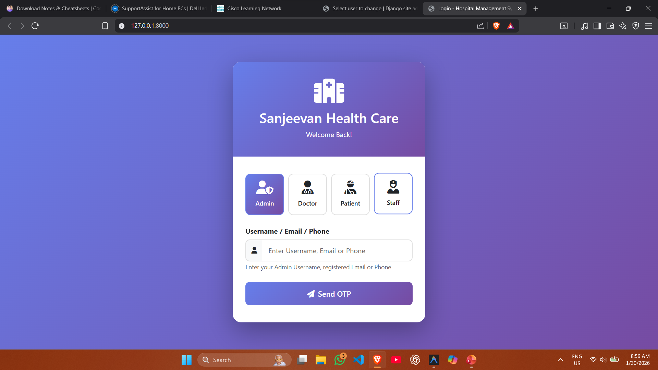

Slide 57
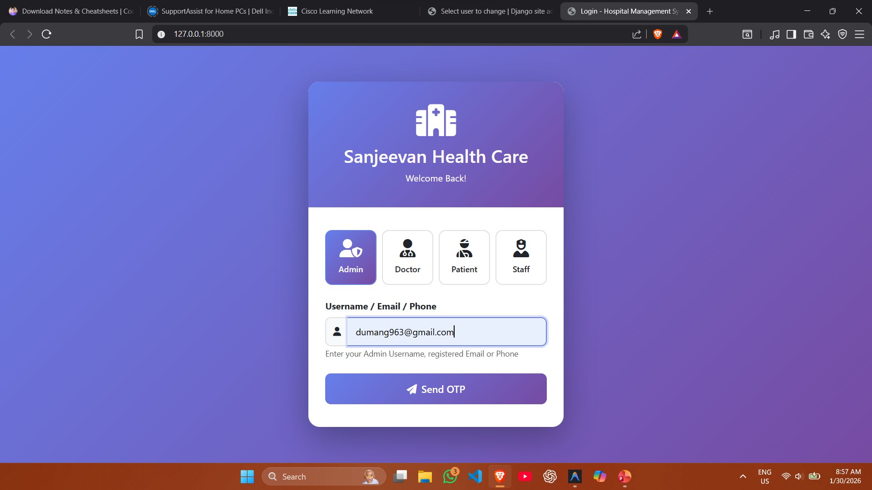

Slide 58
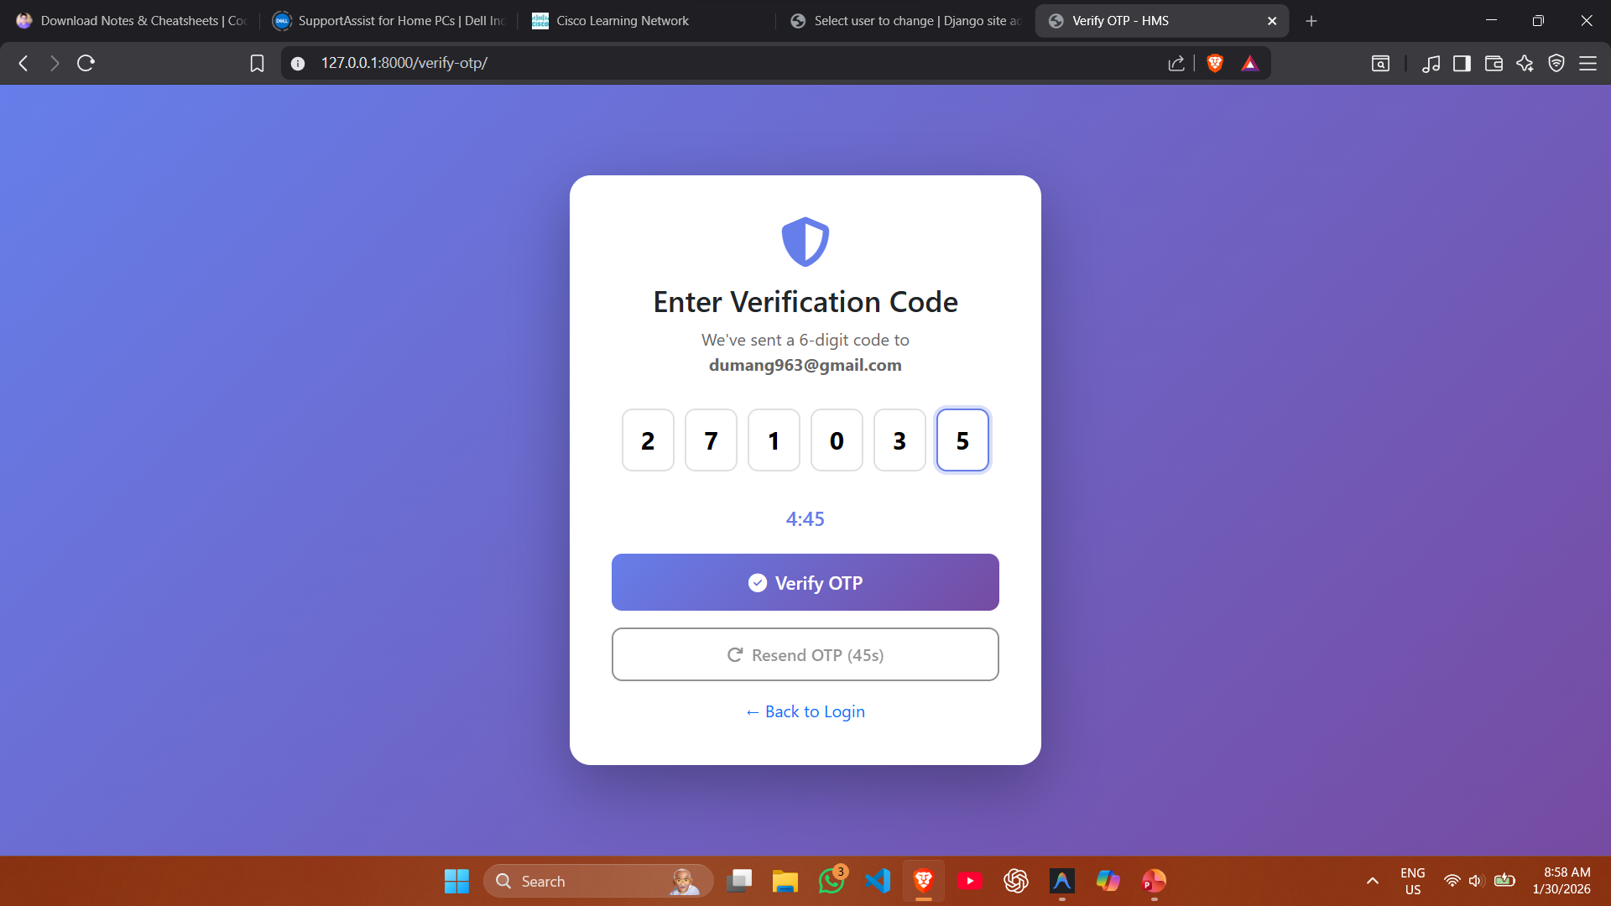

Slide 59
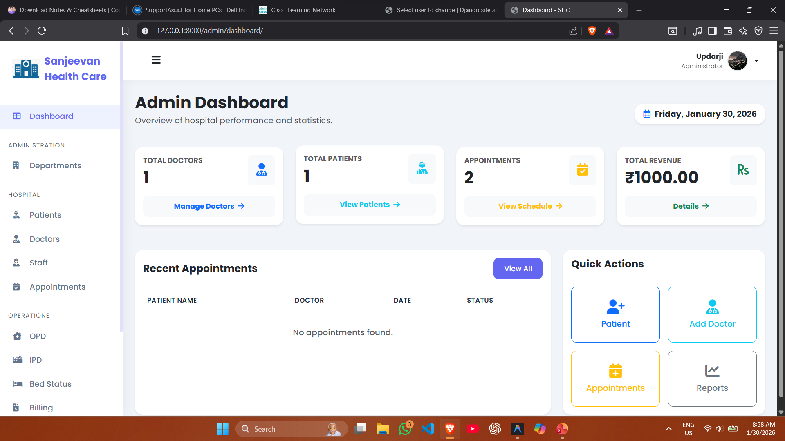

Slide 60
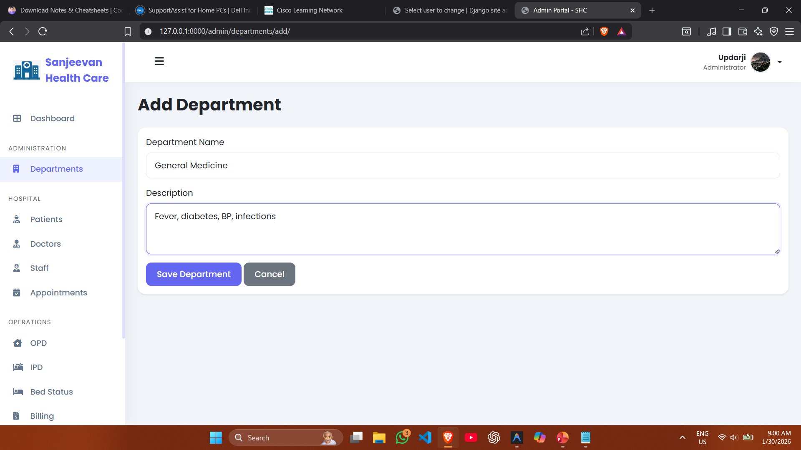

Slide 61
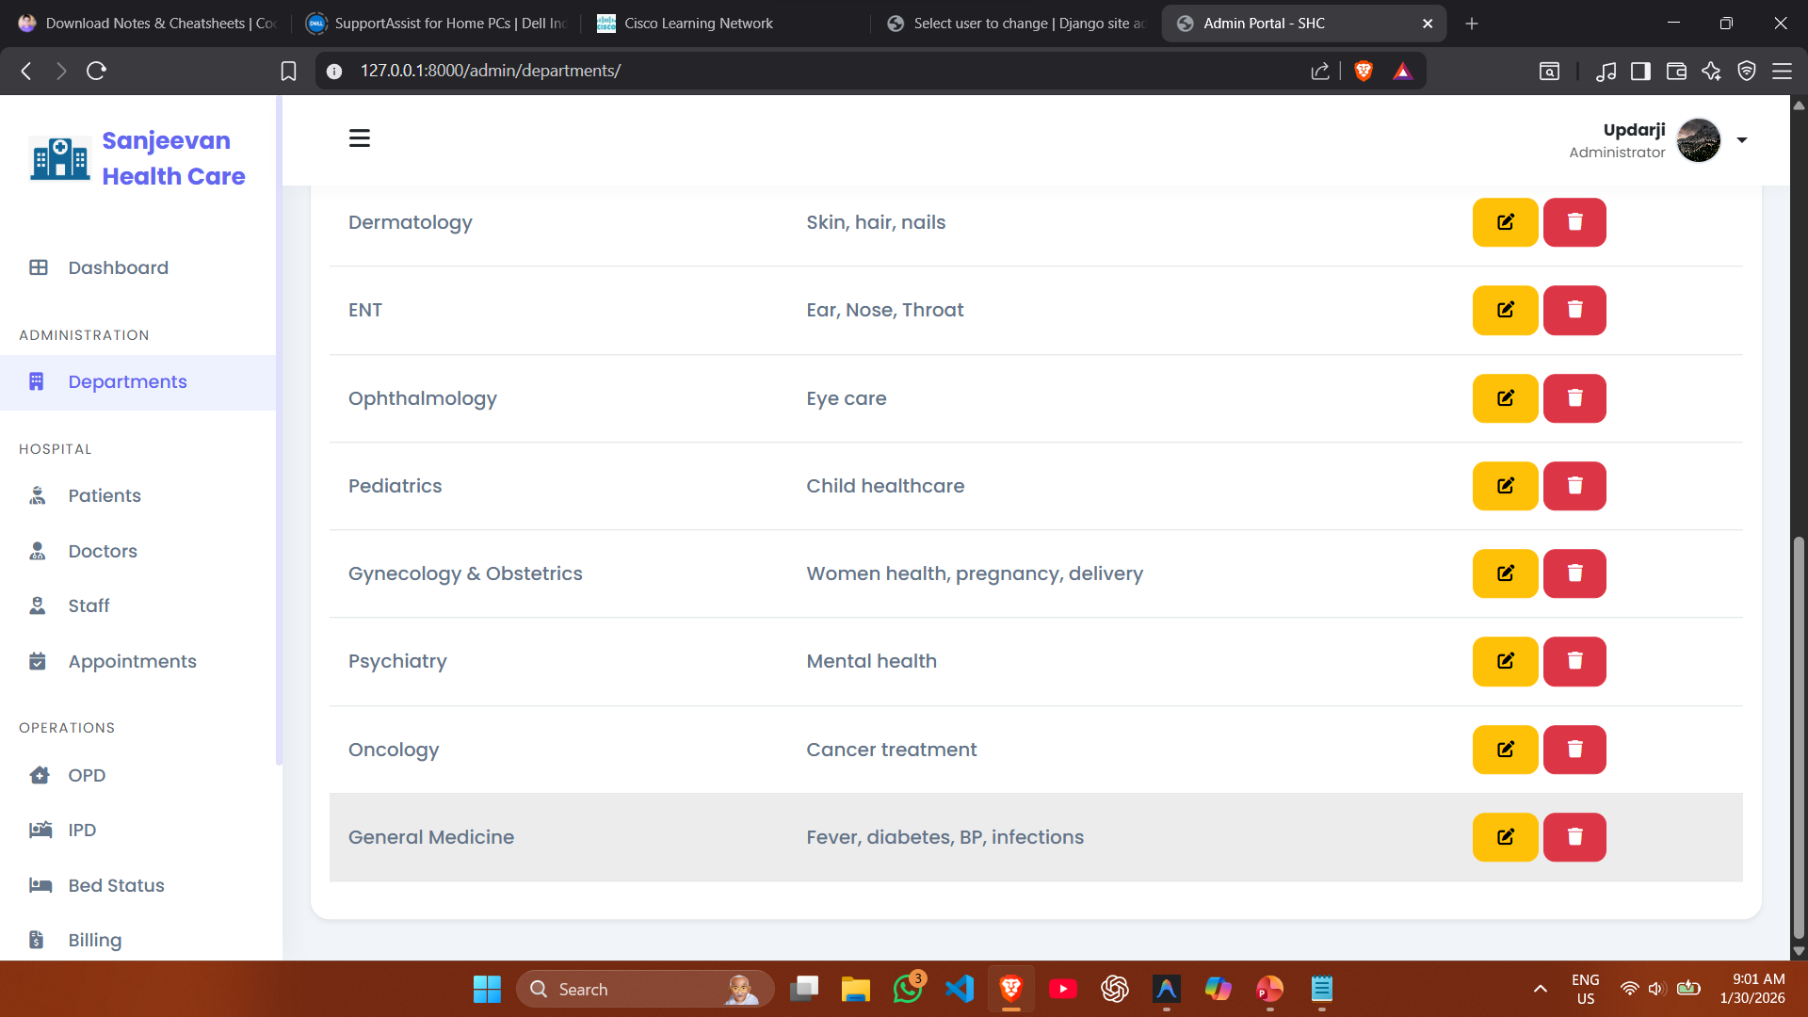

Slide 62
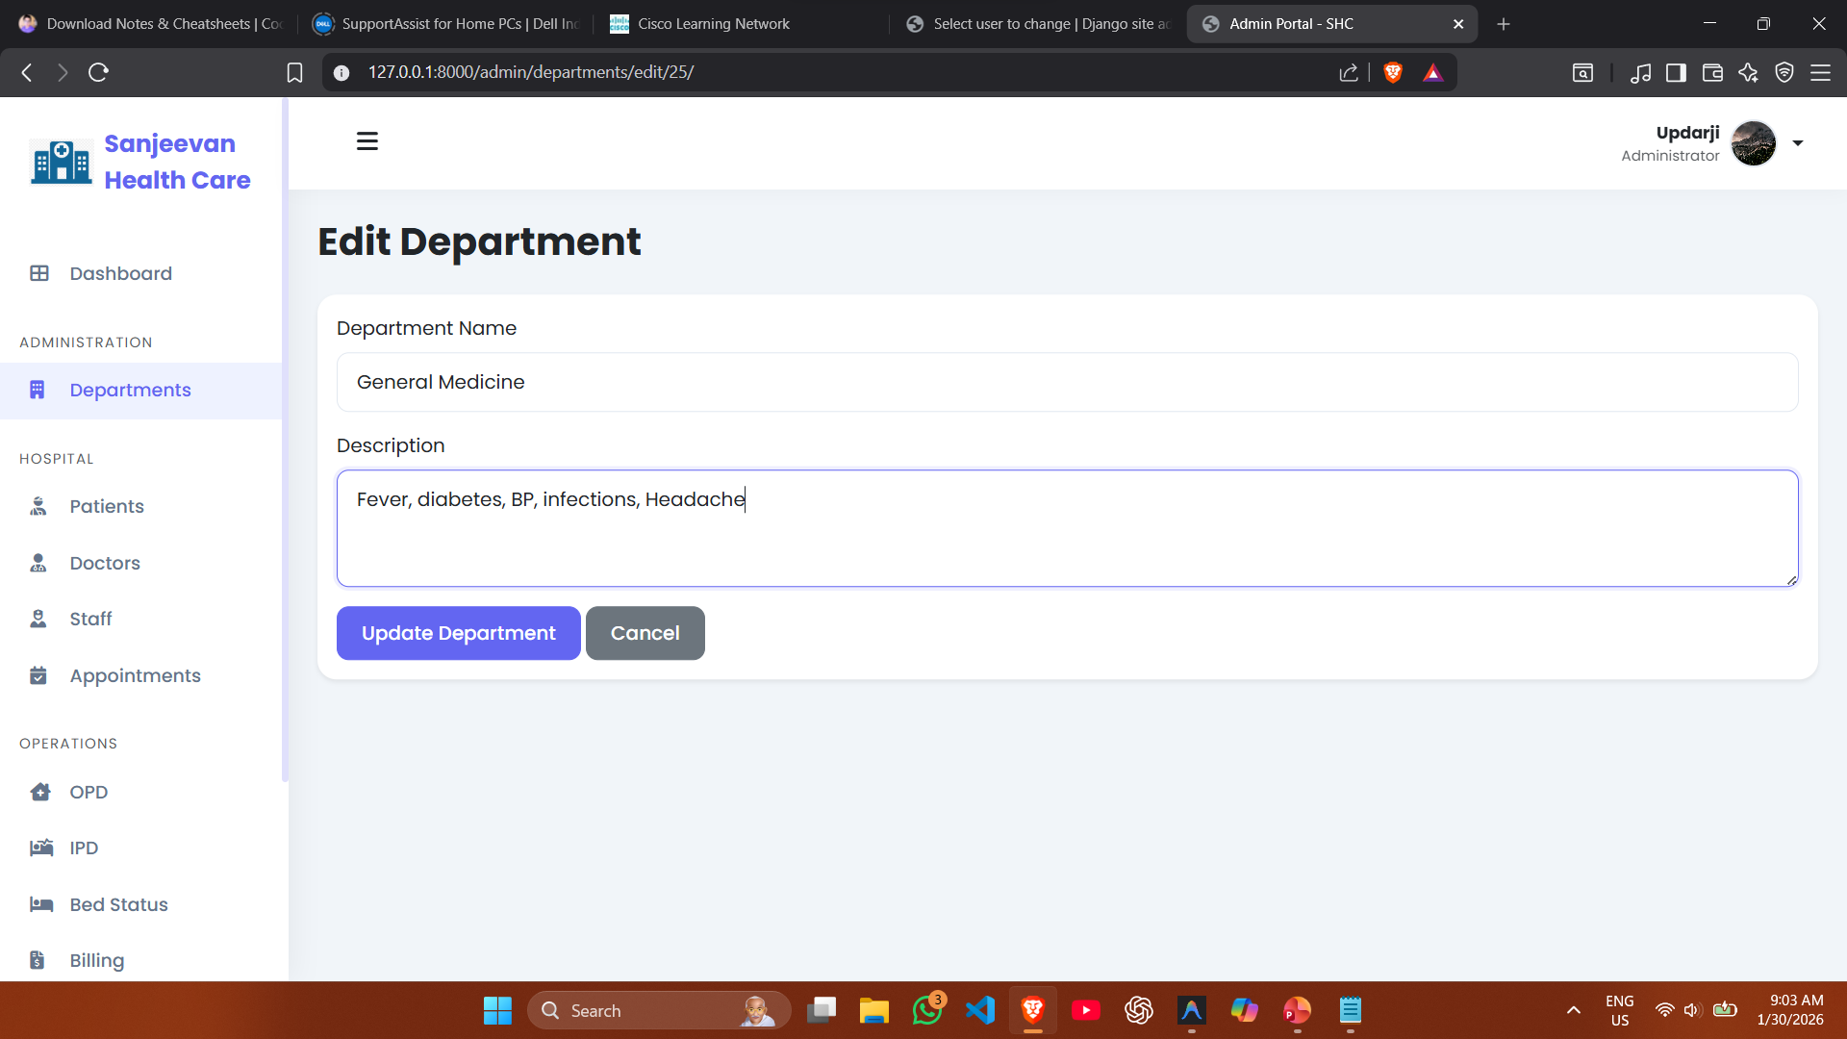

Slide 63
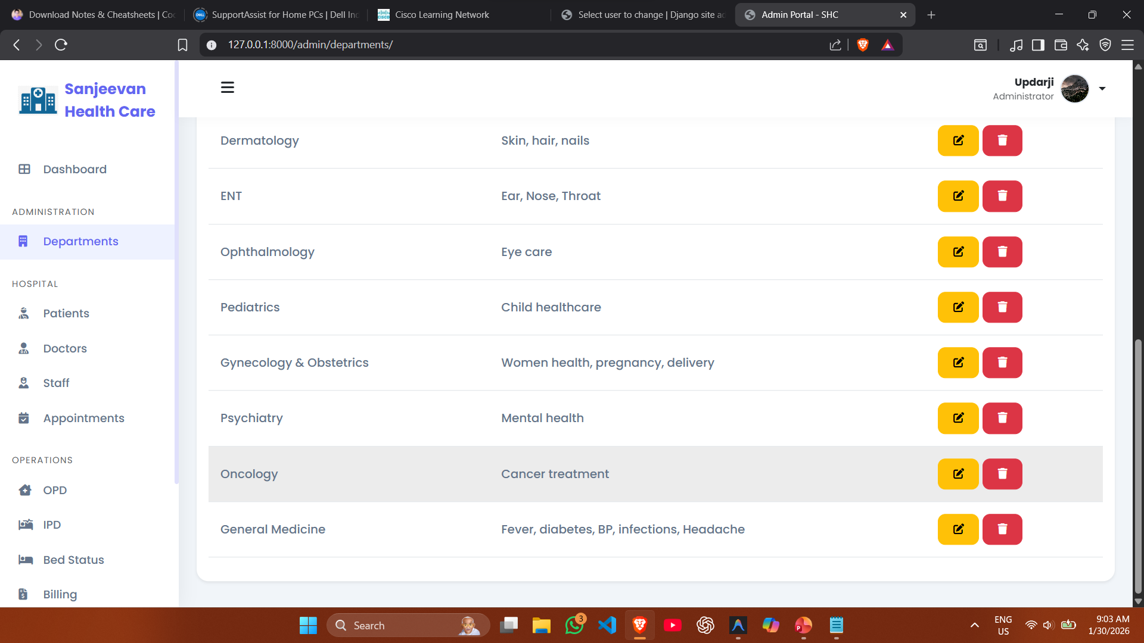

Slide 64
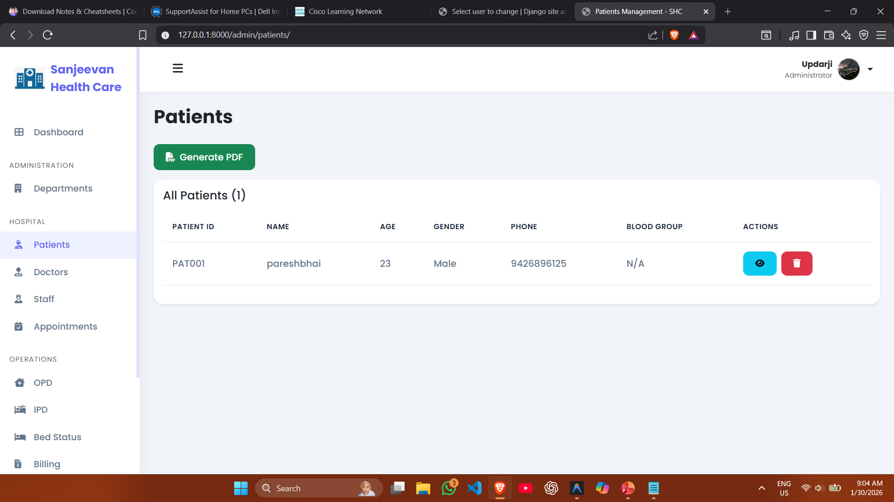

Slide 65
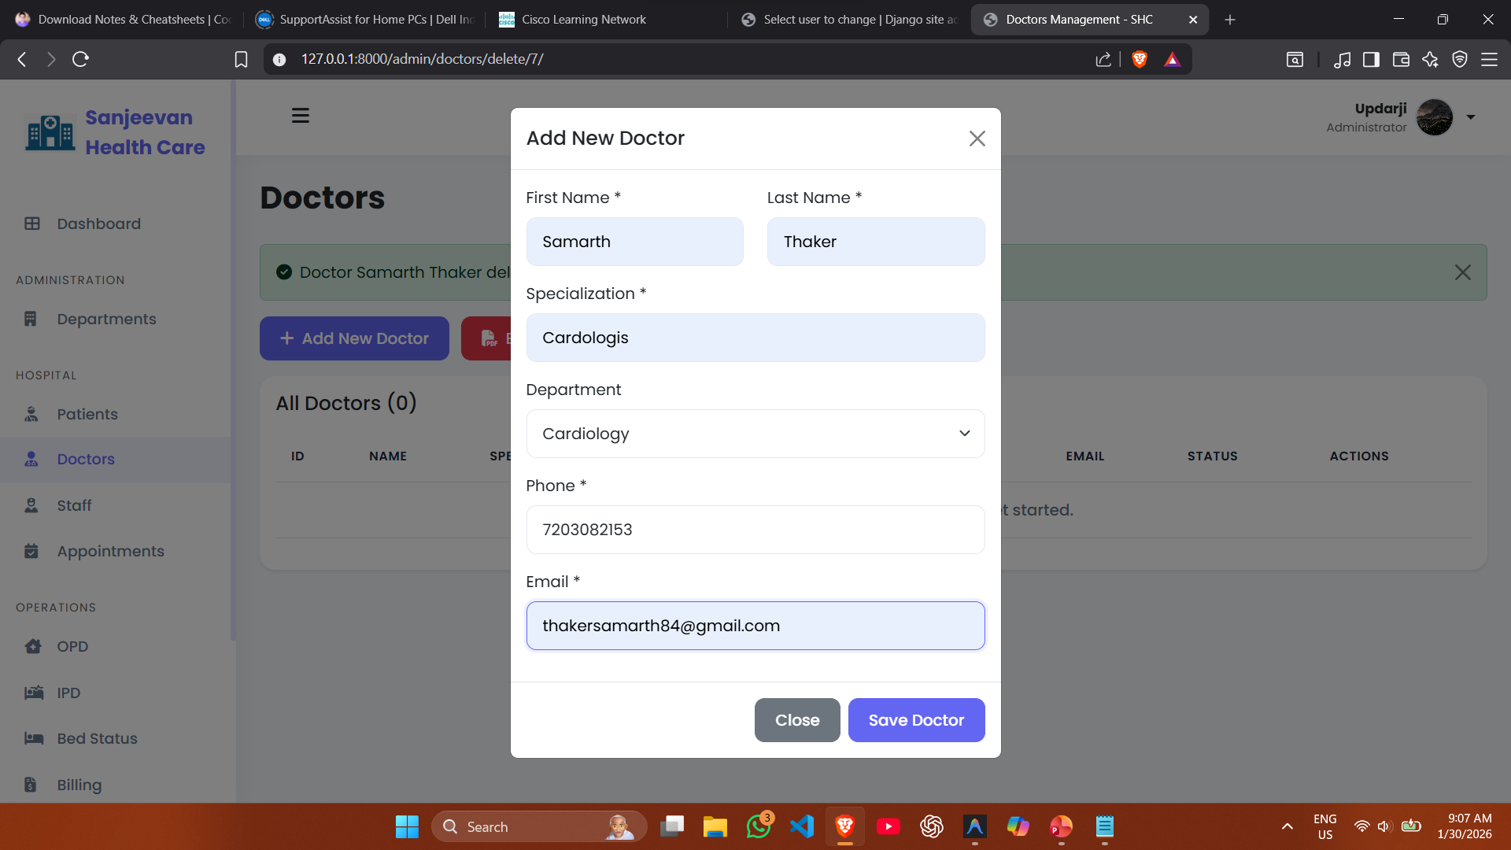

Slide 66
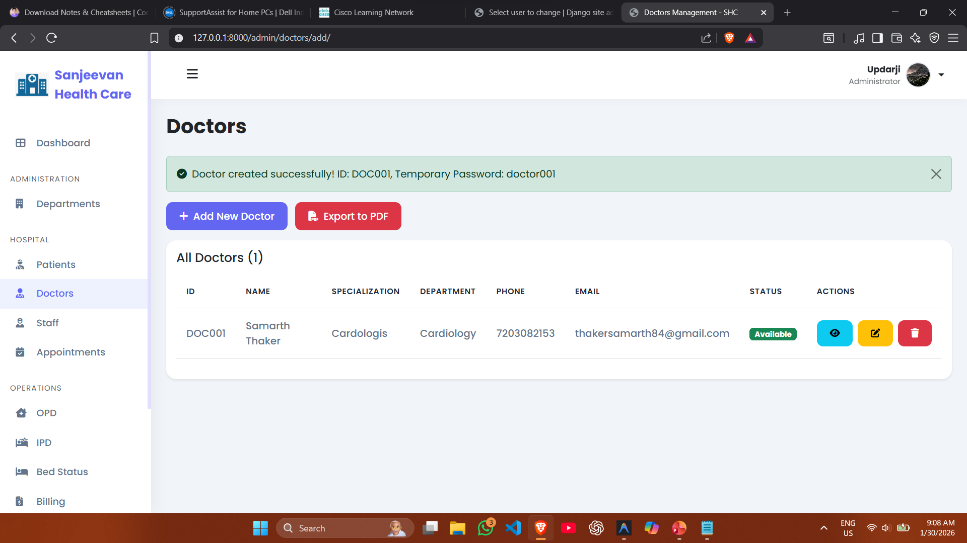

Slide 67
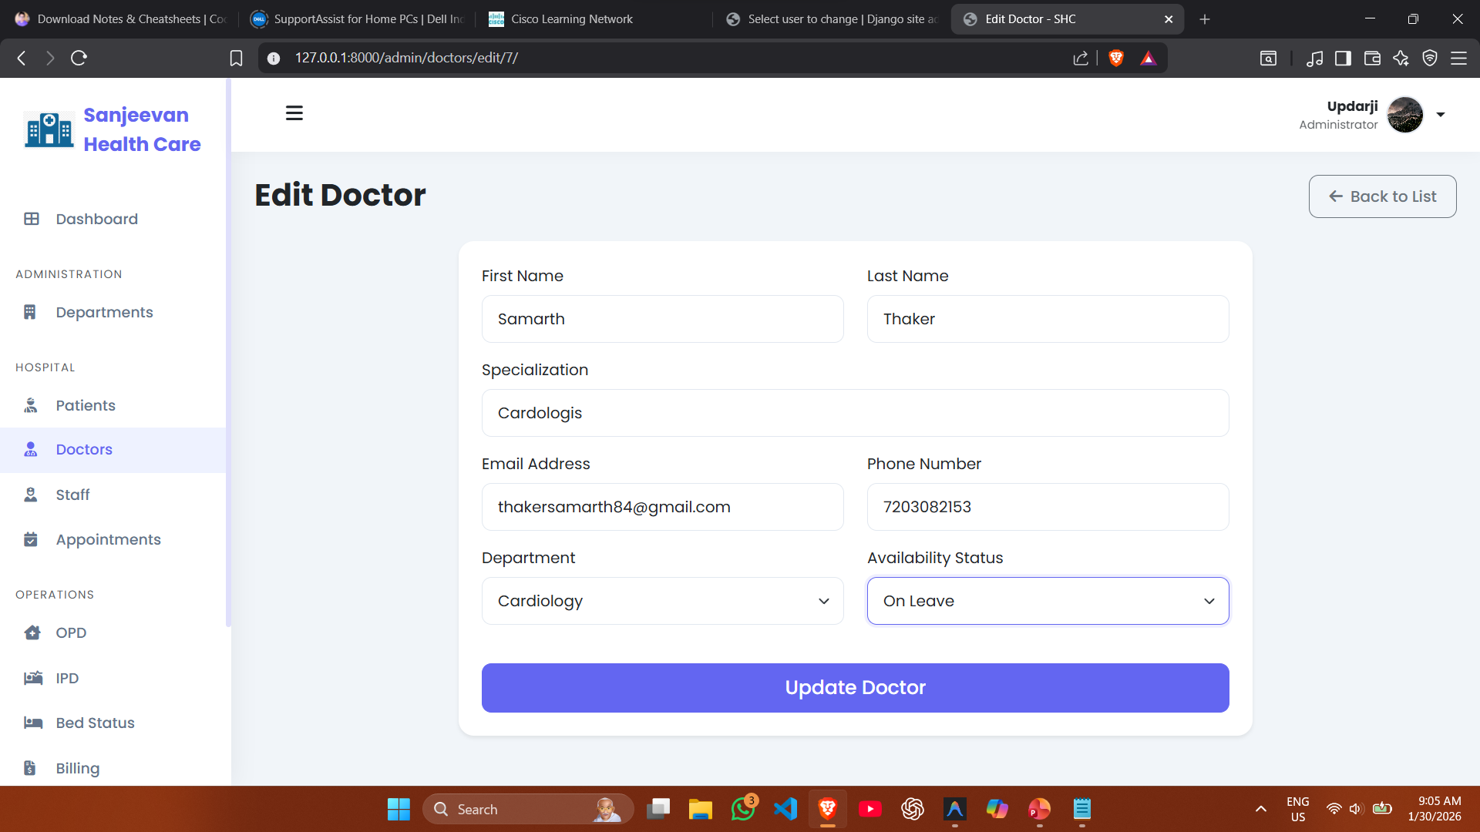

Slide 68
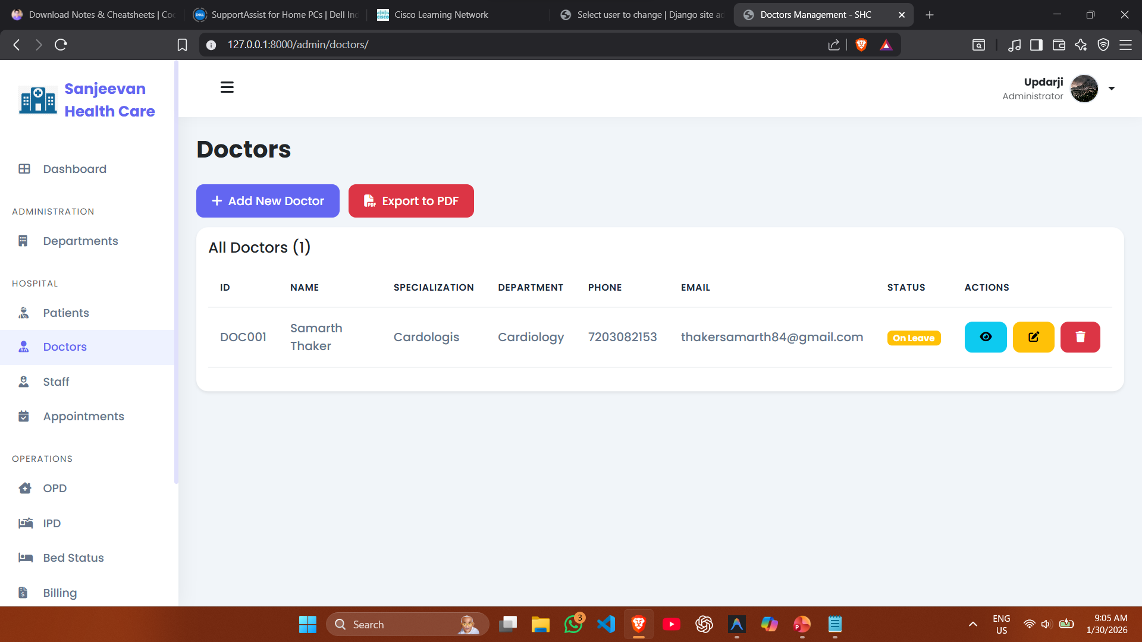

Slide 69
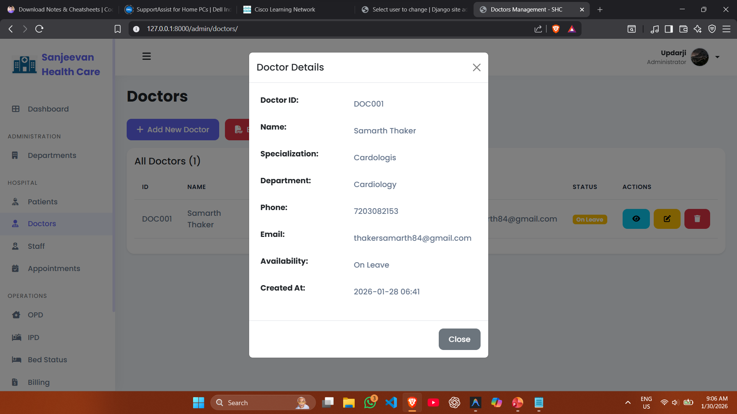

Slide 70
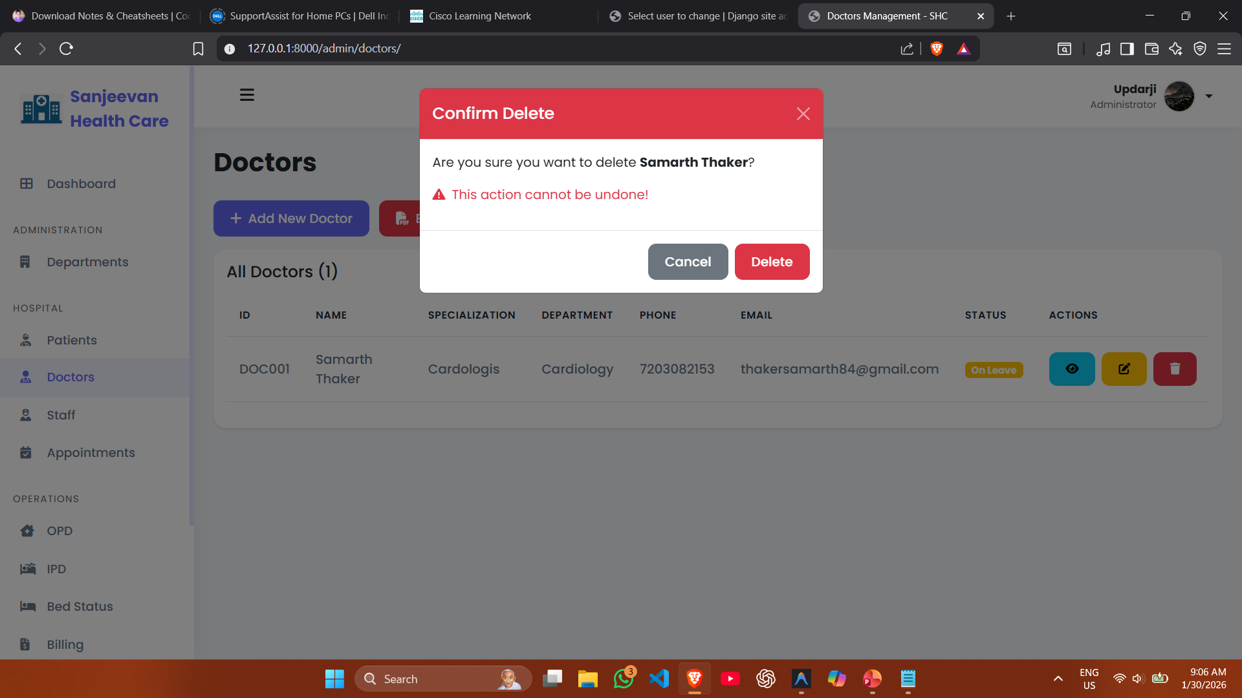

Slide 71
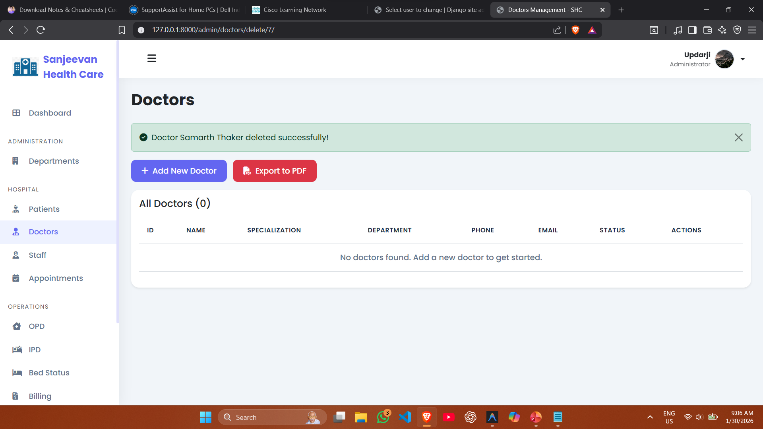

Slide 72
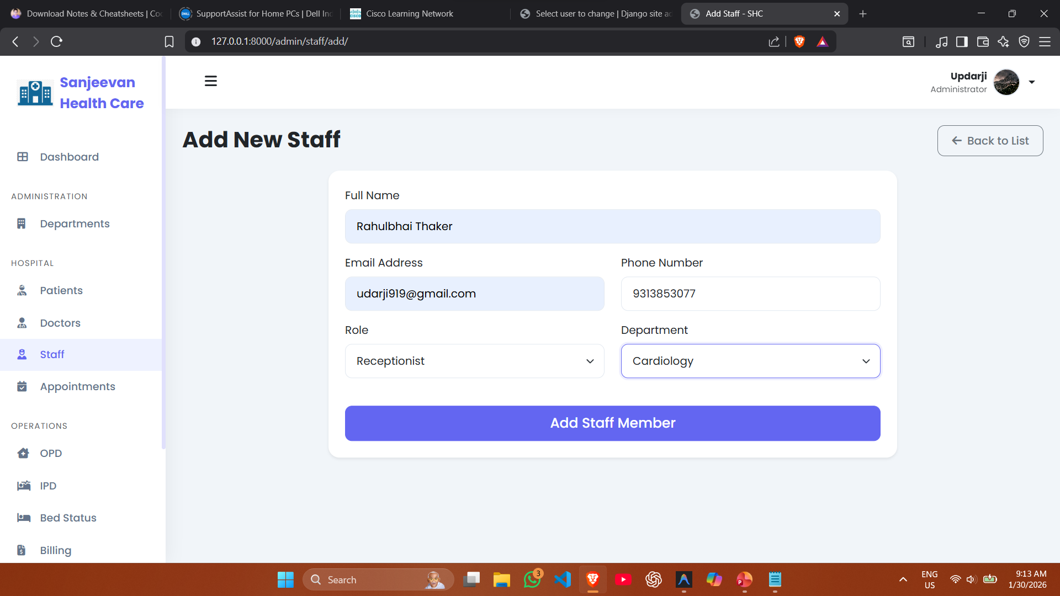

Slide 73
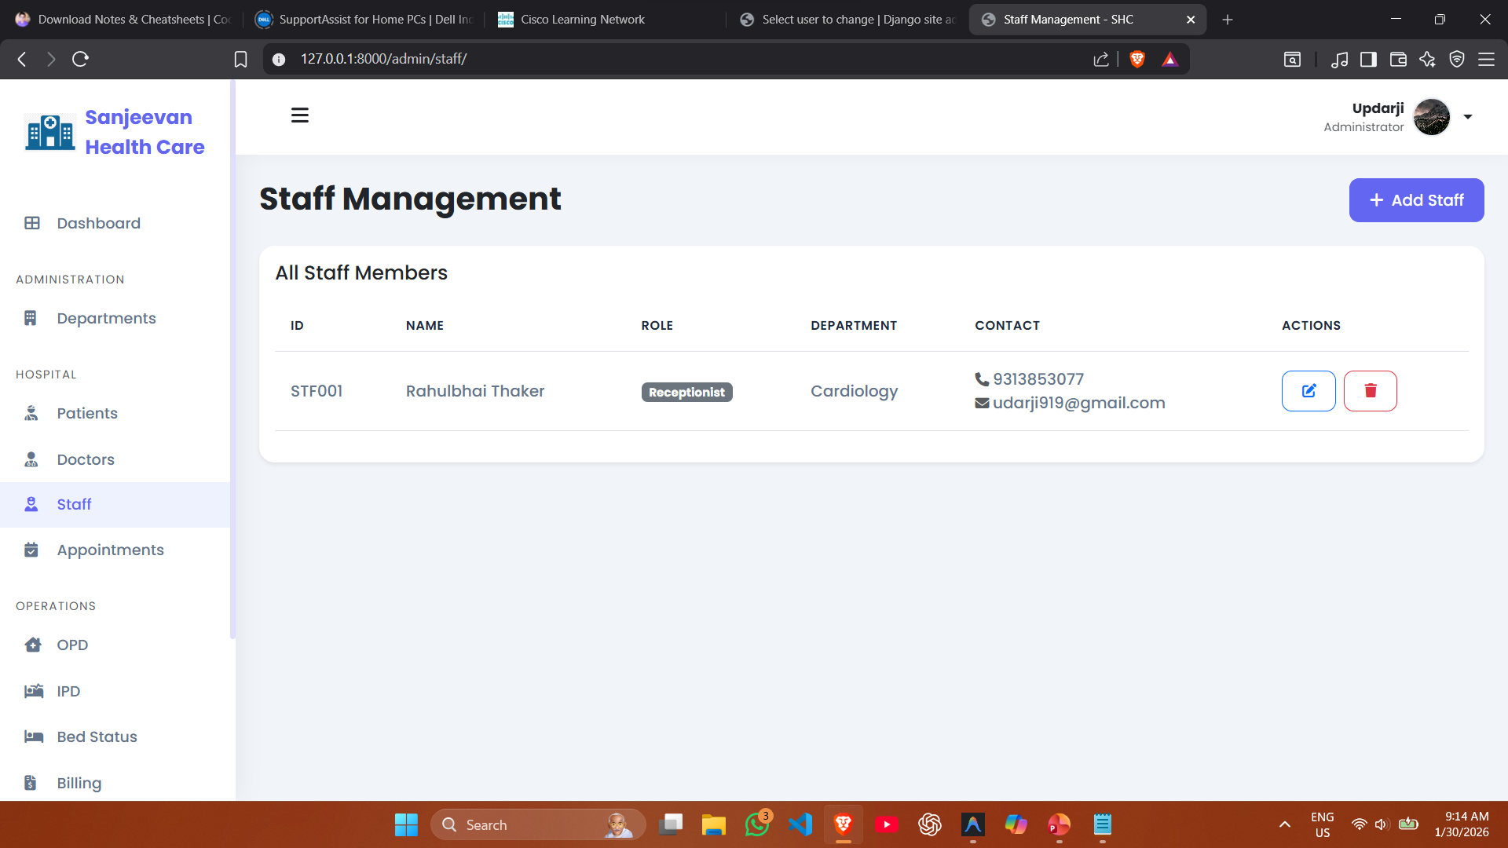

Slide 74
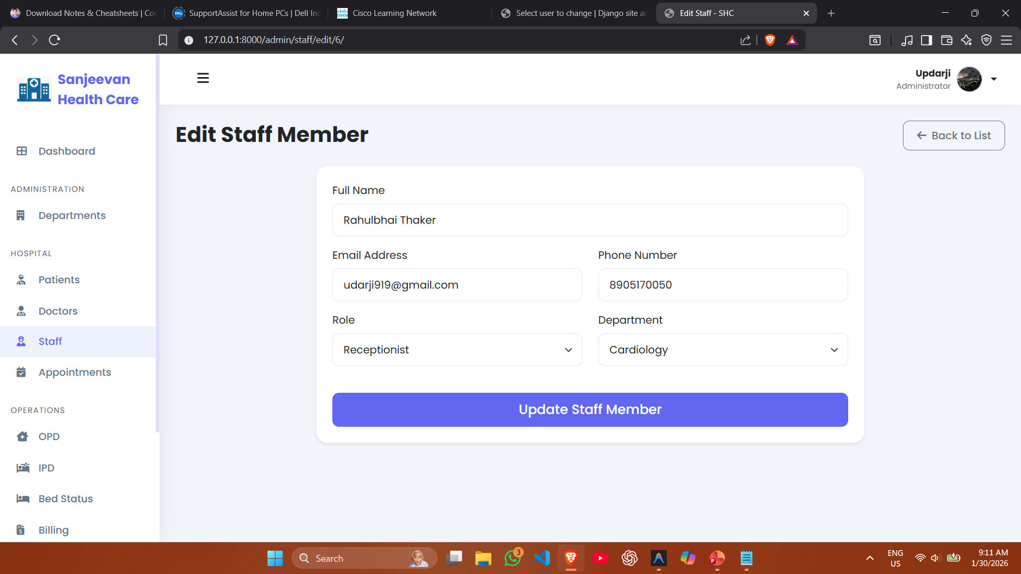

Slide 75


Slide 76
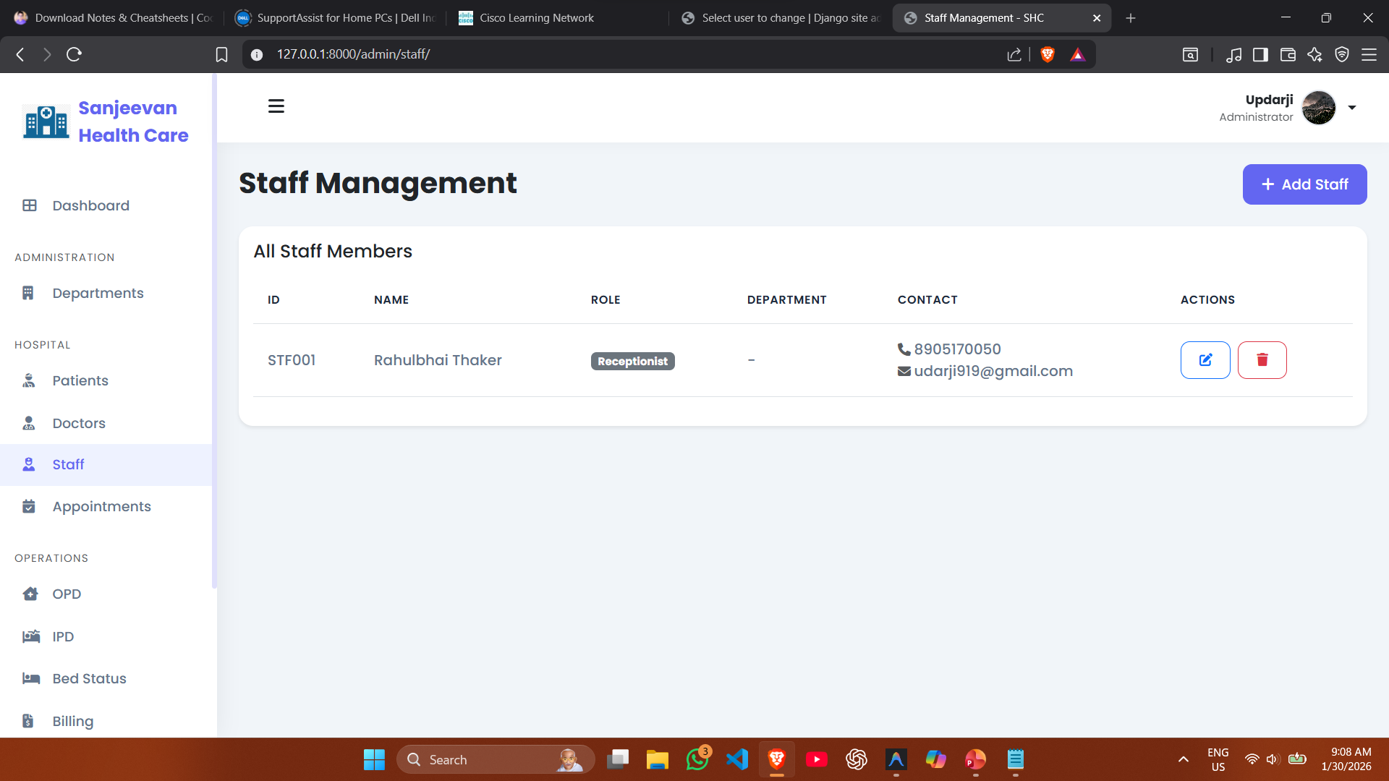

Slide 77
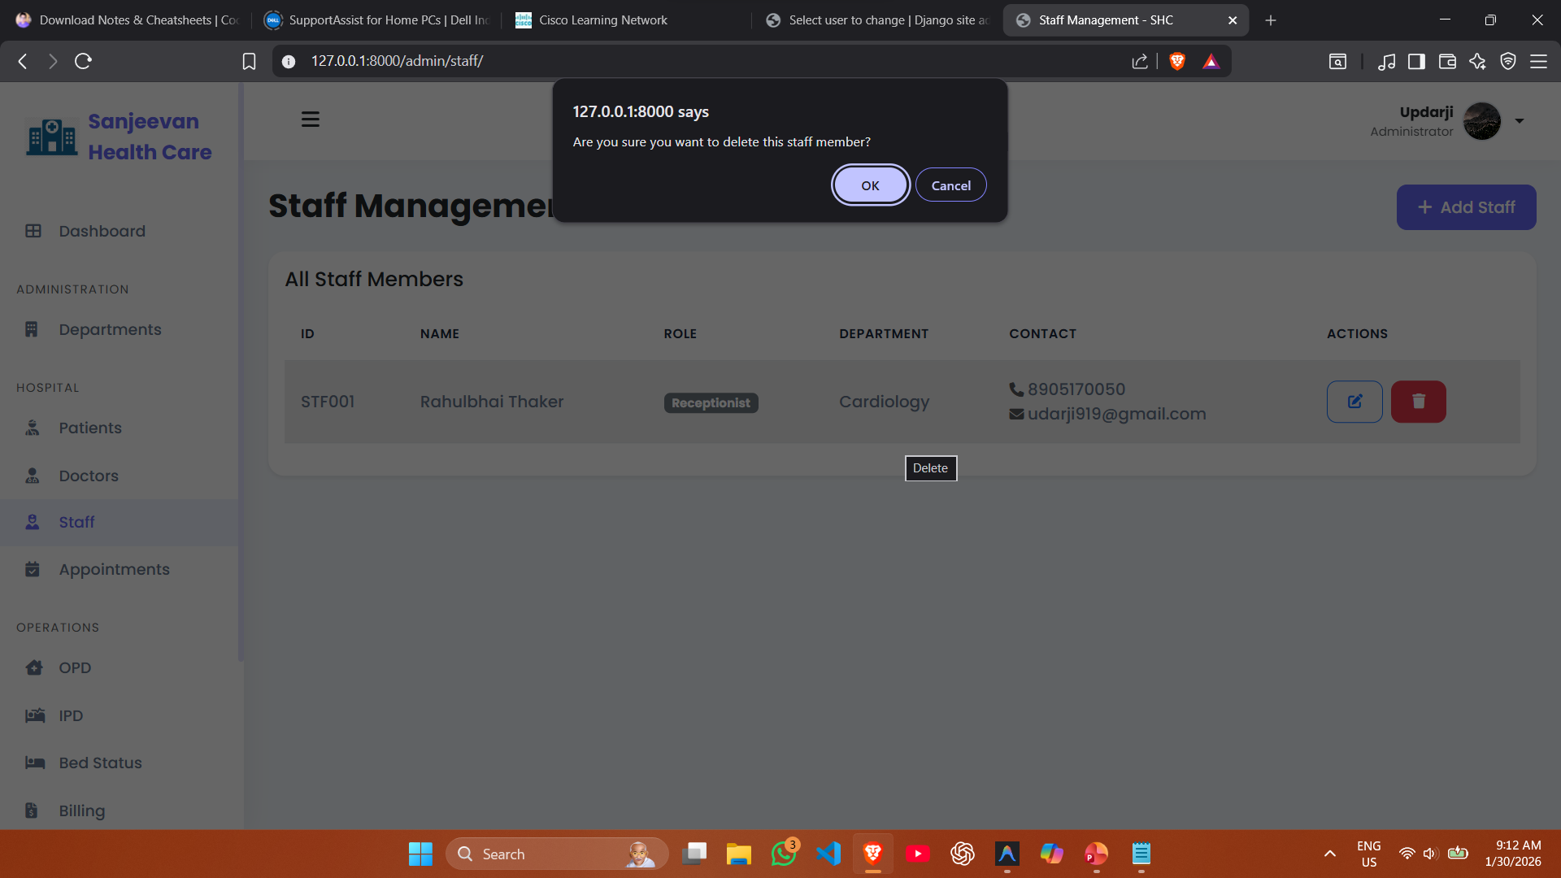

Slide 78
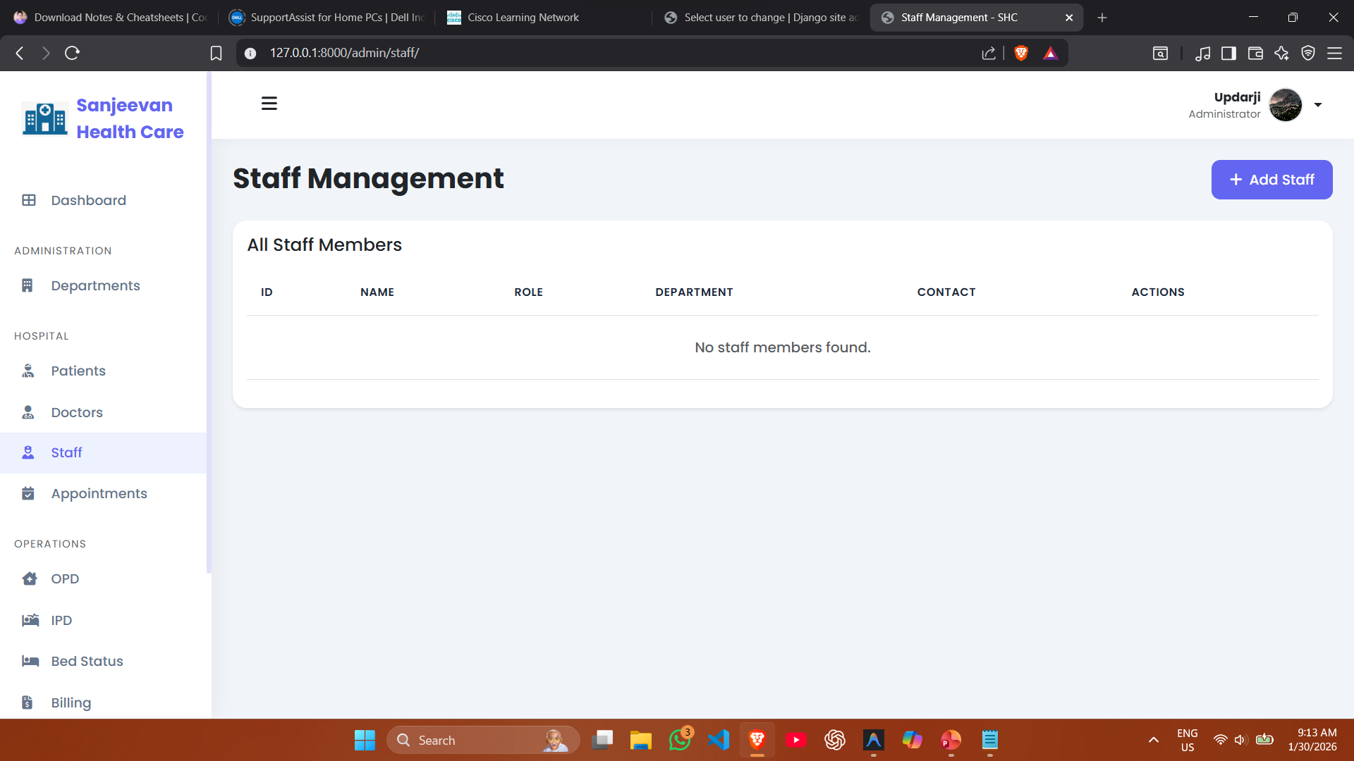

Slide 79
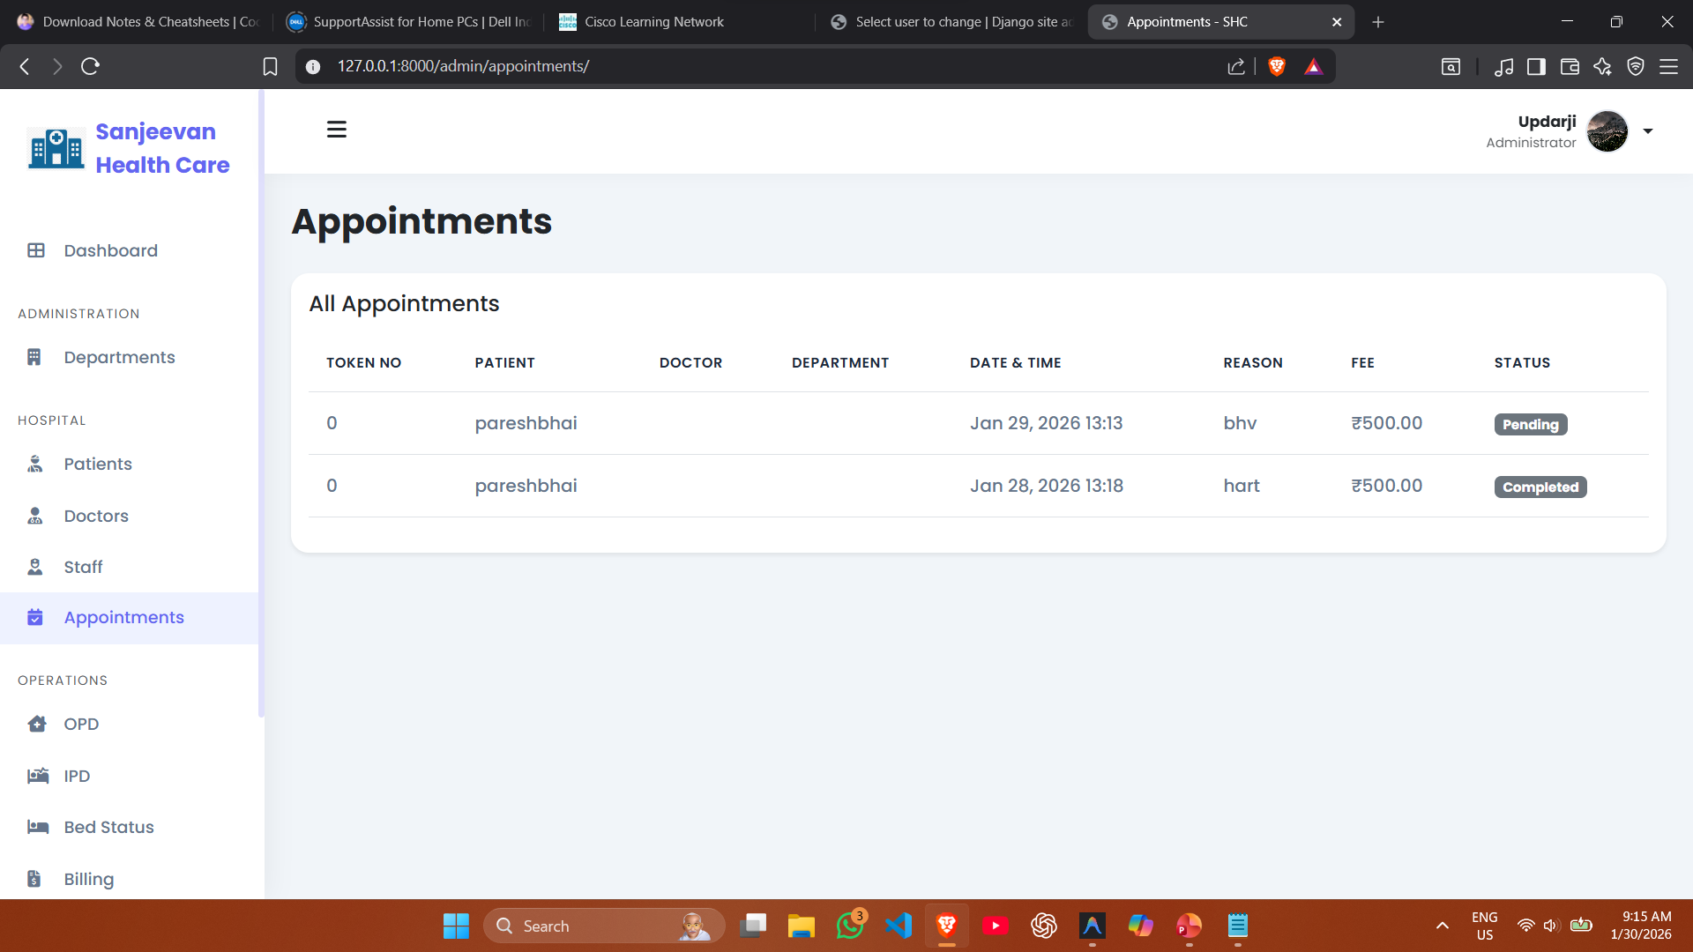

Slide 80
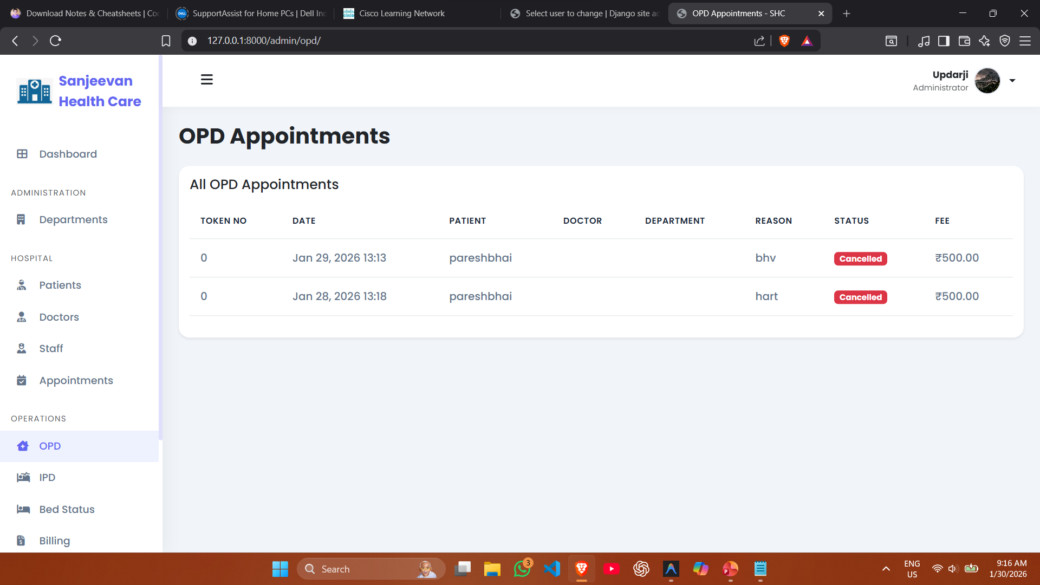

Slide 81
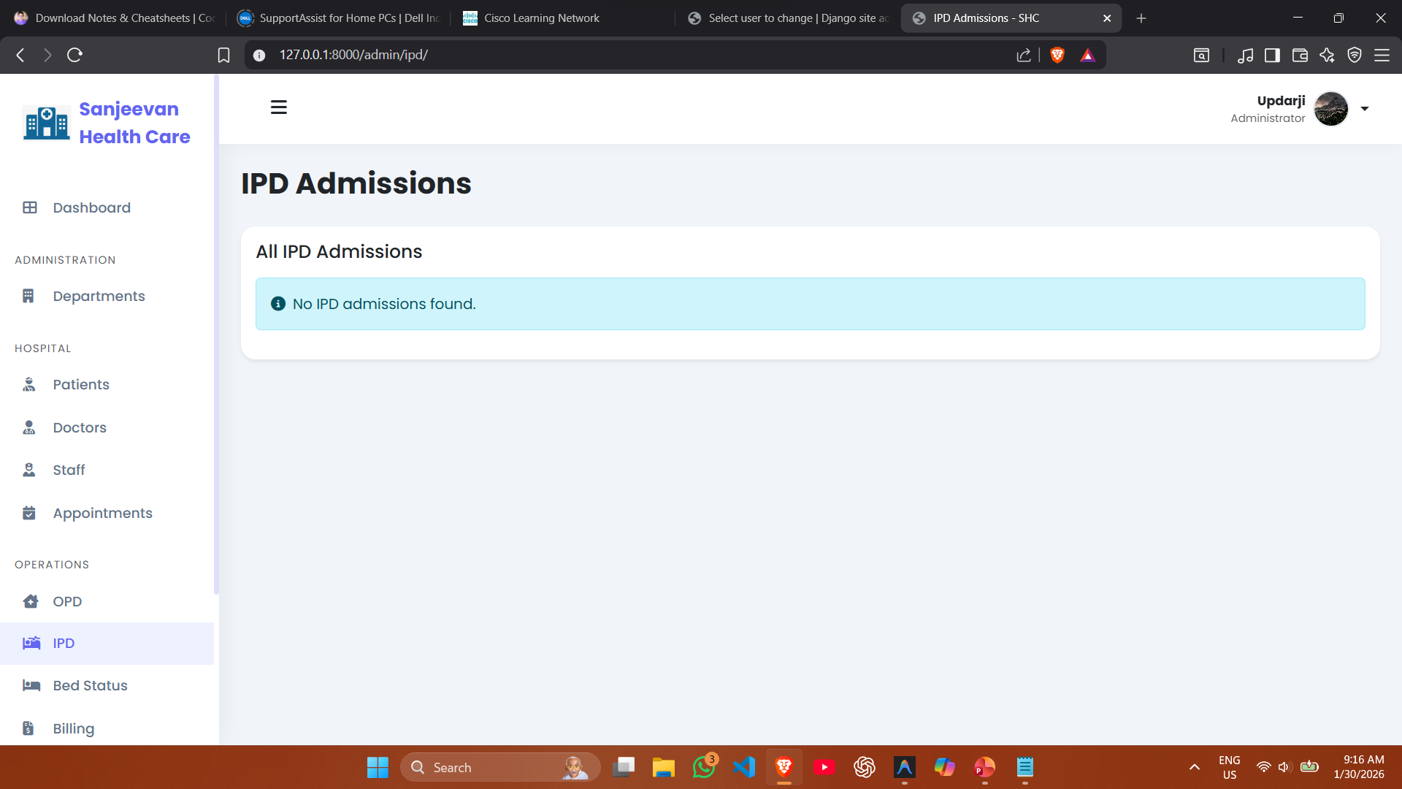

Slide 82
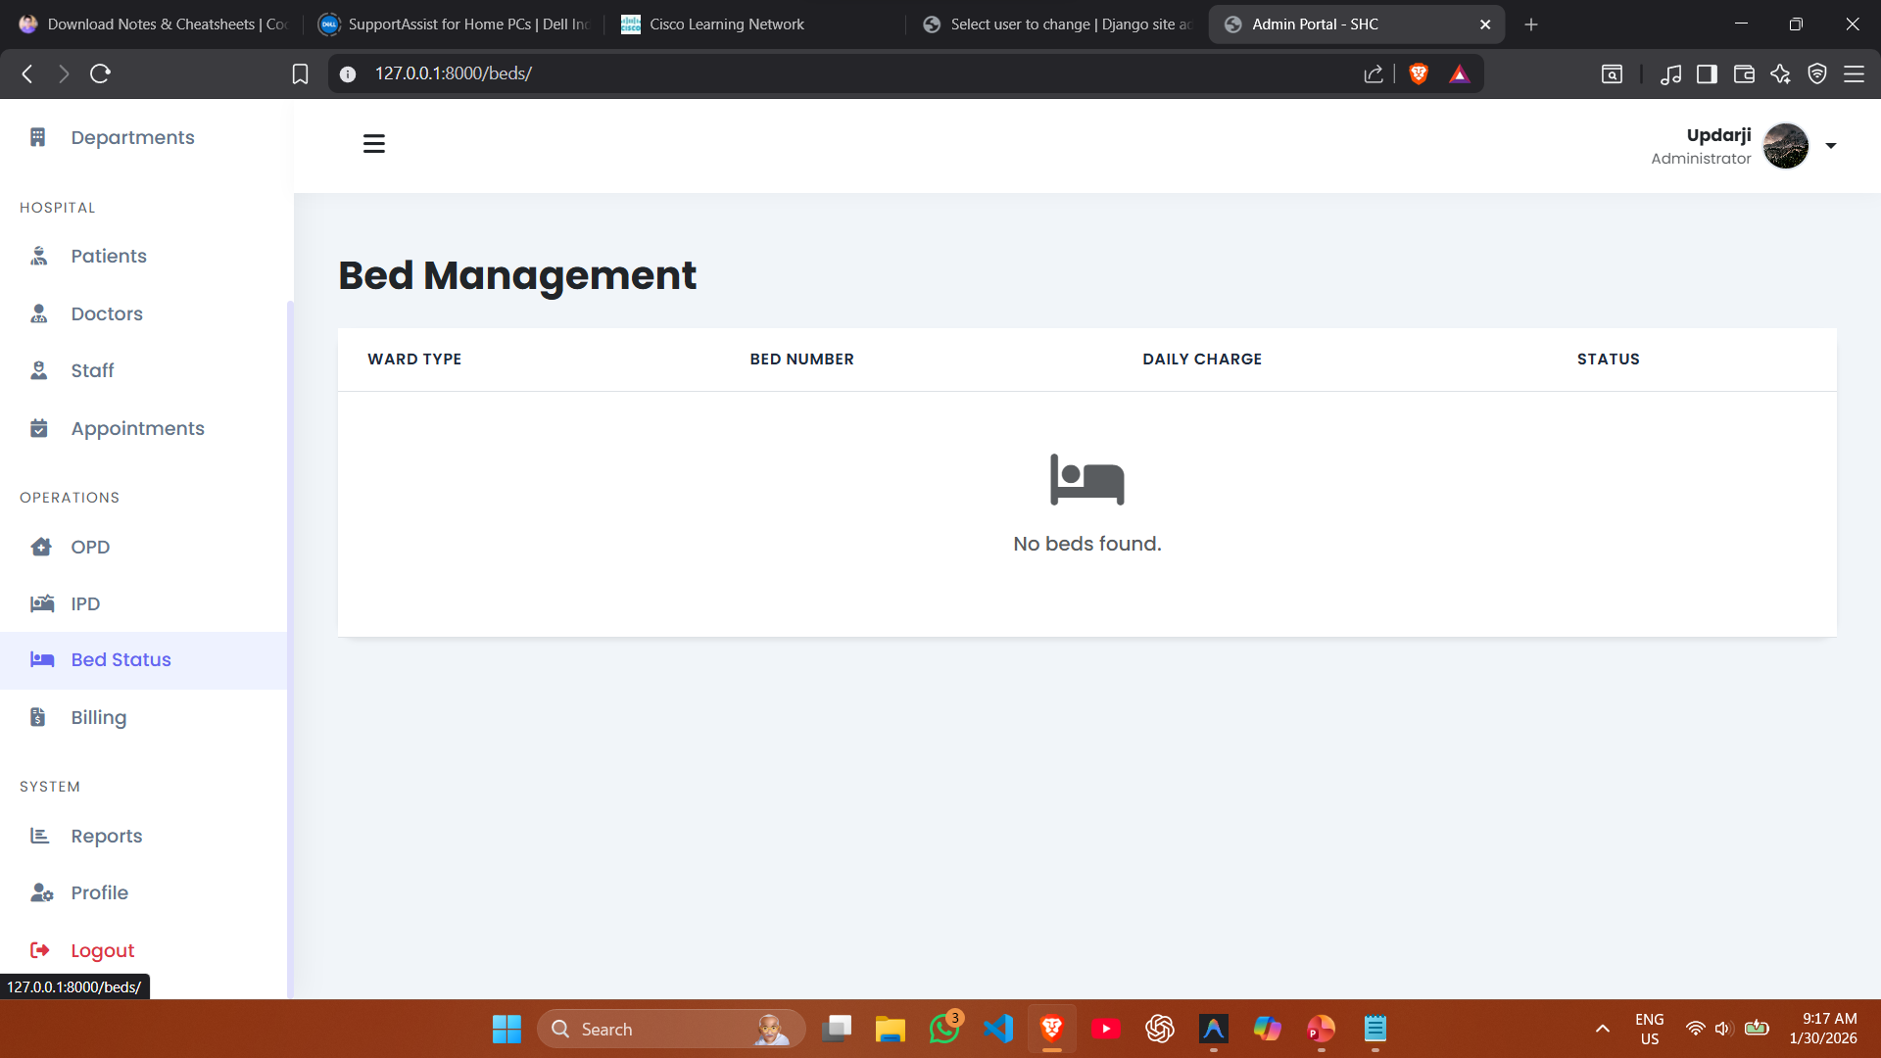

Slide 83
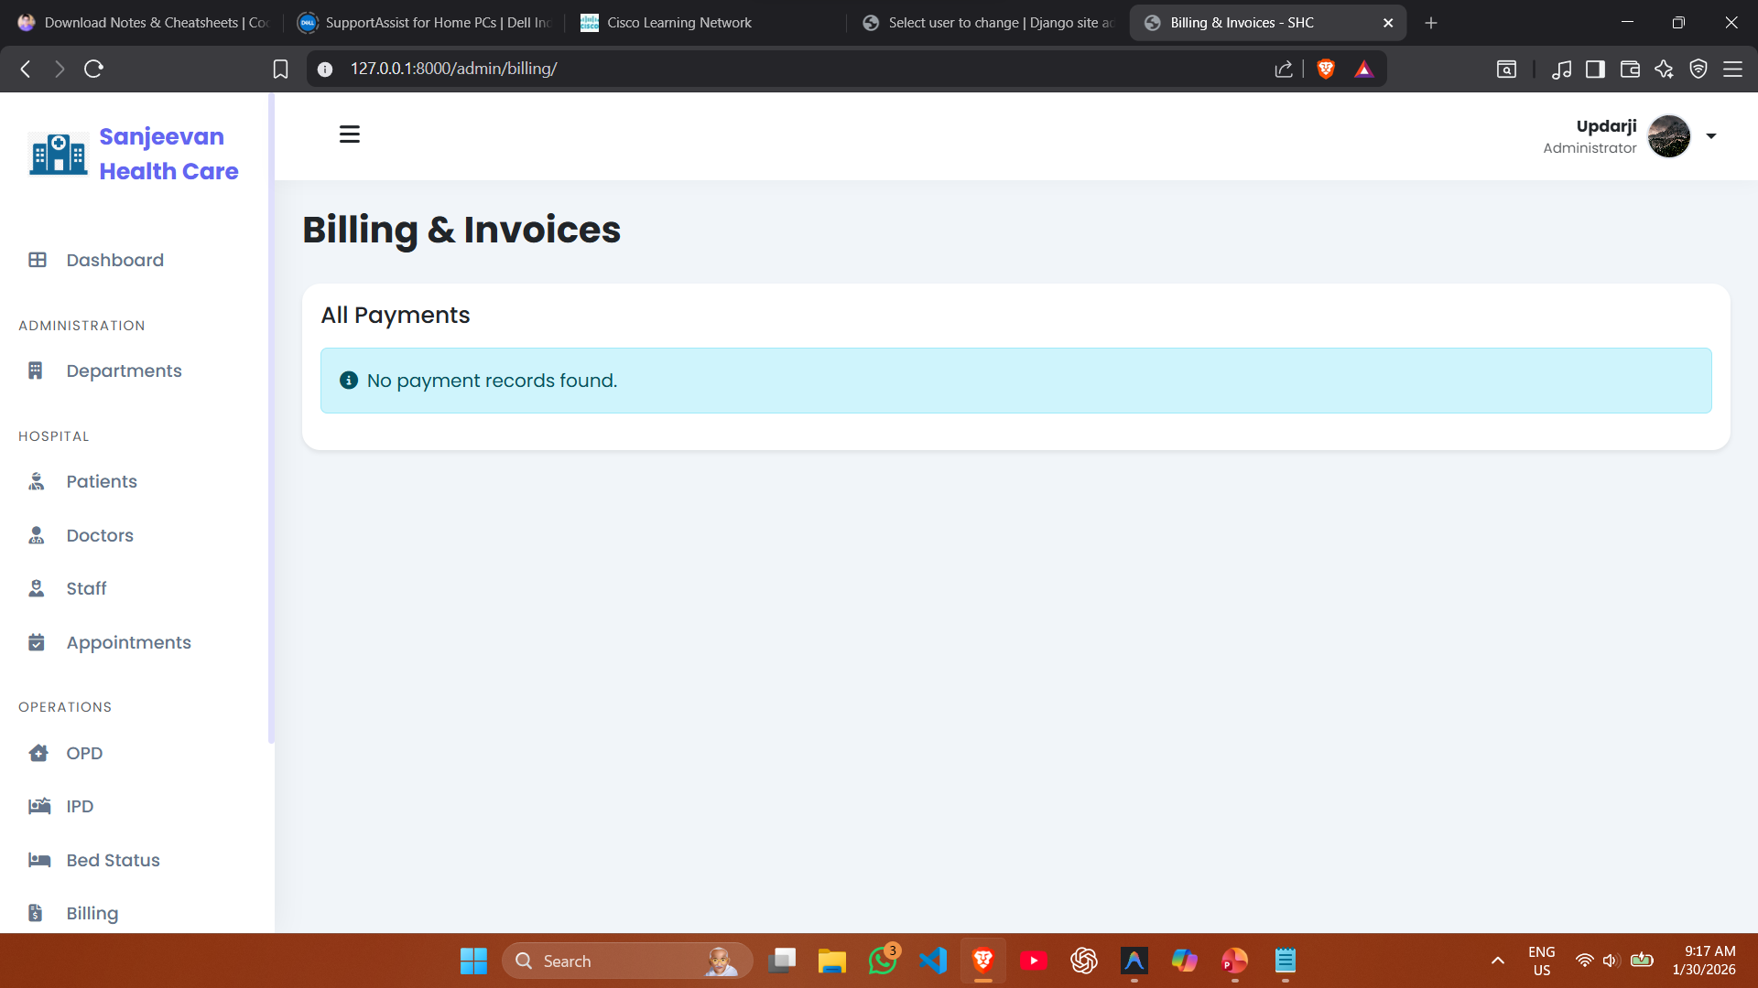

Slide 84
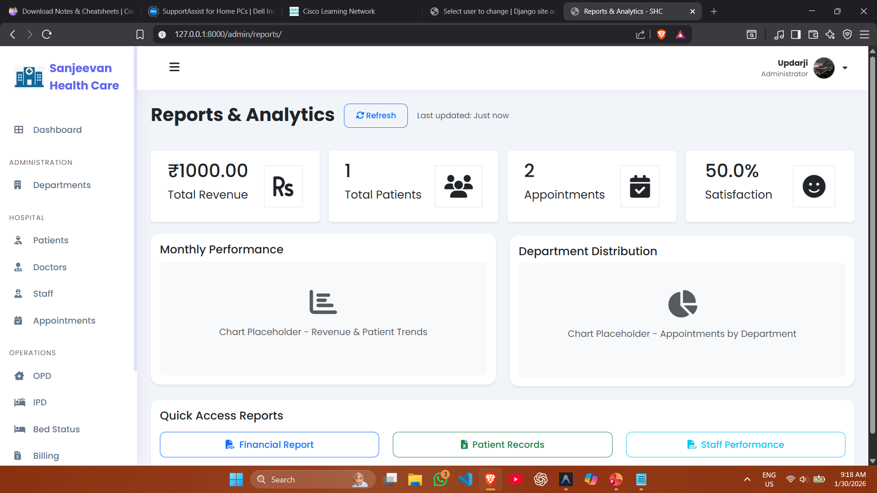

Slide 85
